Slide 1
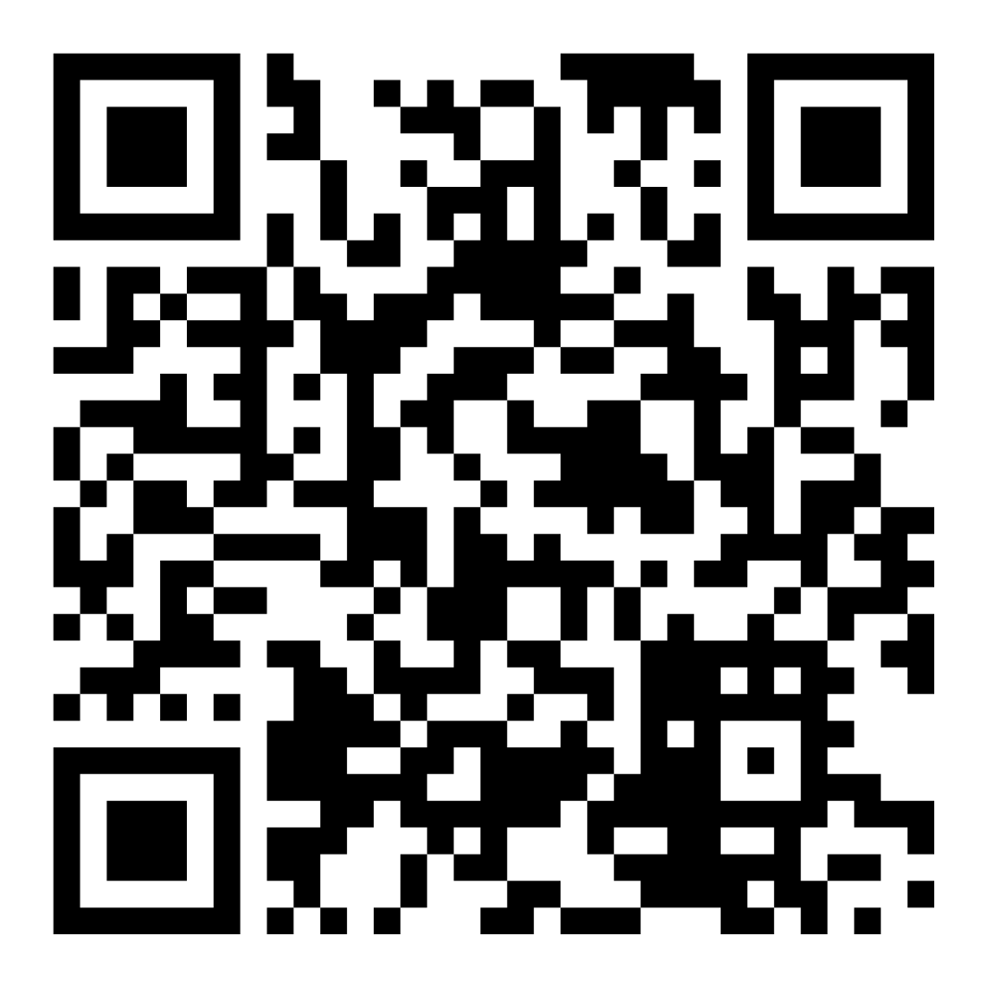
Letter Writing 5.1.25

Slide 2
Overview
Welcome!
About Exodus
Definitions of Different Legal Statuses
Federal Issues
Resuming US Refugee Admissions Program
Ongoing Litigation
Whom to Contact
State Issues
Governor’s Actions
Legislation for next session
Sample Letters & Phone Calls
CWS Action Alerts
Exodus Refugee The Life Ahead

Slide 3
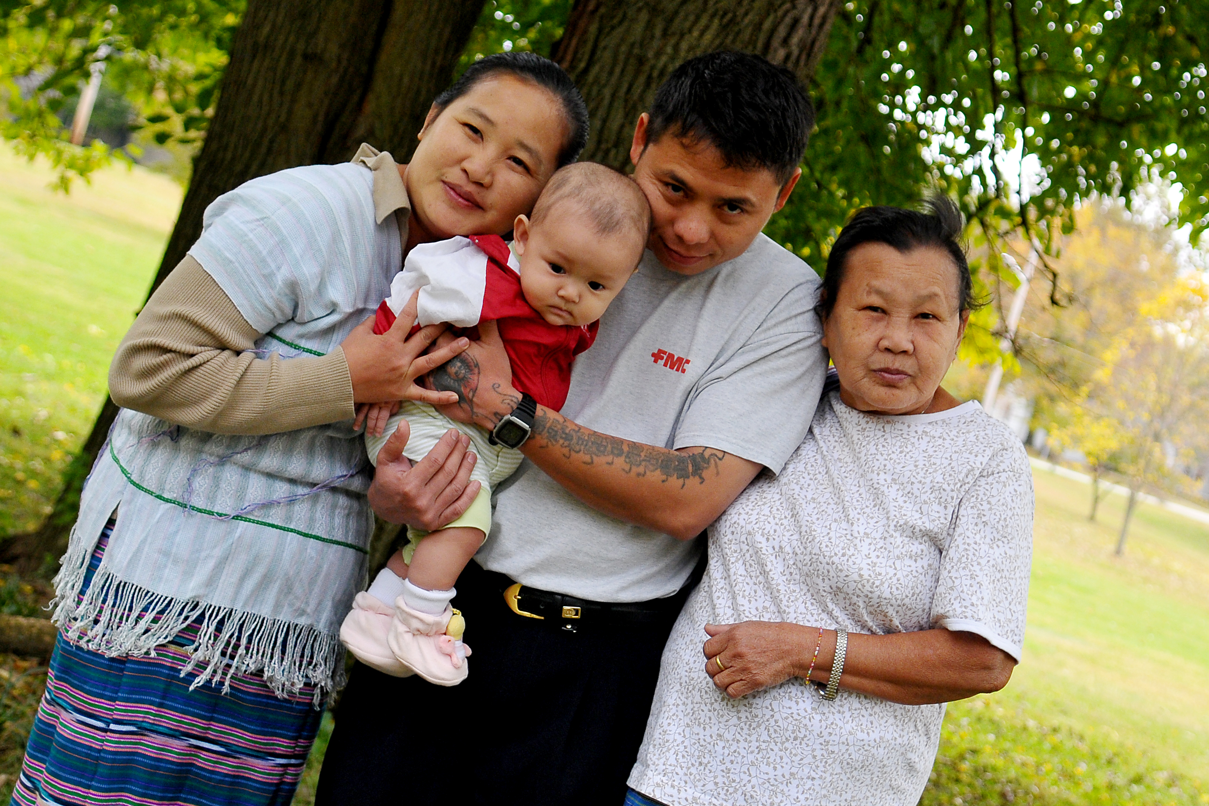
Welcome!
Thank you for joining us today!
Every voice matters, and we appreciate you taking the time to use yours in support of our immigrant neighbors.
The key part of advocating is sharing your why – why do you care about an issue and how does it impact you/your community?
Exodus Refugee The Life Ahead

Slide 4
Exodus Refugee

Slide 5
Mission Statement
Exodus Refugee Immigration is dedicated to the protection of human rights by serving the resettlement needs of refugees and other displaced people fleeing persecution, injustice, and war by welcoming them to Indiana.
Exodus Refugee The Life Ahead
Notes:
Founded in 1981 assisting Cuban Refugees during the Mariel Boat lift. Exodus actually started by a group of local volunteers holed up in the basement of their local church. Putting their collective skillsets together, they found a way to help people rebuild a new life. Today, though we have a growing team of trained and licensed professionals to lead the charge in resettlement efforts, volunteers are still a crucial element of the resettlement effort. This is because while my colleagues and I are the entry point for refugees entering our city, volunteers are one of the primary sources through which the community at large provides a warm welcome to newcomers looking to build a new life in peace, safety, and hope. Not only are Exodus staff members willing to walk with them, but they have a large group of everyday people ready and excited to walk alongside our clients as well. The expectation of relationship that we have on all front – including staff members – is being support people, and by no means saviors. Our role is to fill in the gaps of understanding and help impart skills with the aim that our clients will take ownership of their life and progress in further into their personal goals. This is the reality of our mission: be the bridge by which people who have already suffered so much can rebuild their lives for themselves and their families.

Slide 6
Definitions

Slide 7
A refugee is someone who…
“Owing to a well-founded fear of being persecuted for reasons of race, religion, nationality, membership of a particular social group, or political opinion, is outside the country of his nationality, and is unable to or, owing to such fear, is unwilling to avail himself of the protection of that country." -(1951 Refugee Convention)
Exodus Refugee The Life Ahead
Notes:
Speaking of the definition of a refugee, there was an official definition developed during the Refugee Convention of 1951. Simply put, and according to leading refugee resettlement experts, refugees are people who have fled war, violence, conflict or persecution and have crossed an international border to find safety in another country.

Slide 8
What is Humanitarian Parole?
Parole is granted on a case-by-case basis.
Allows entry into the US for individuals who would otherwise be ineligible to enter
For individuals with urgent humanitarian needs like medical emergencies or family reunification
Provides temporary protection from deportation
Is not a path to green card or permanent residency in the US
Exodus Refugee The Life Ahead
Notes:
Definitions can be confusing when discussing legal statuses for individual. Here are some practical definitions we will use and expound upon later in our discussion. We’ve already discussed who a refugee is, so let’s briefly talk about asylum seekers and migrants.
An asylum seeker is someone who has left their country and is seeking protection from persecution and serious human rights violations but hasn't yet been legally recognized as a refugee and is waiting to receive a decision on their asylum claim. We will go over asylum seekers more in-depth later in this presentation.
On the contrary, a migrant is a person staying outside their country of origin, who is not an asylum seeker or a refugee. Some migrants leave their country because they want to work, study, or join family. Others leave because of poverty, political unrest, gang violence, or natural disasters.

Slide 9
What is Temporary Protected Status (TPS)?
TPS is granted to groups of people: eligible nationals of certain countries.
Granted to people who are already in the U.S. so that they may remain in the U.S. for a set period of time.
Granted due to conditions in the country that temporarily prevent the country's nationals from returning safely such as:
Ongoing armed conflict (such as civil war)
An environmental disaster (such as earthquake), or an epidemic
Other extraordinary and temporary conditions
Provides temporary protection from deportation
Is not a path to a green card or permanent residency in the U.S.
Exodus Refugee The Life Ahead
Notes:
Definitions can be confusing when discussing legal statuses for individual. Here are some practical definitions we will use and expound upon later in our discussion. We’ve already discussed who a refugee is, so let’s briefly talk about asylum seekers and migrants.
An asylum seeker is someone who has left their country and is seeking protection from persecution and serious human rights violations but hasn't yet been legally recognized as a refugee and is waiting to receive a decision on their asylum claim. We will go over asylum seekers more in-depth later in this presentation.
On the contrary, a migrant is a person staying outside their country of origin, who is not an asylum seeker or a refugee. Some migrants leave their country because they want to work, study, or join family. Others leave because of poverty, political unrest, gang violence, or natural disasters.

Slide 10
Who is an asylum seeker?
An asylum seeker is someone seeking international protection and has applied for asylum or intends to do so.
While refugee status is processed abroad, asylum is processed in the U.S.
To be eligible for asylum, an individual “must demonstrate a well-founded fear of persecution based on:
race,
religion,
nationality,
membership in a particular social group,
or political option.”
Six months after filing for asylum, asylum seekers are eligible for a work permit.
People who are seeking asylum are waiting years to have their cases heard by an immigration judge or other immigration official.
Asylum is a path to a green card or permanent residency.
Exodus Refugee The Life Ahead
Notes:
Definitions can be confusing when discussing legal statuses for individual. Here are some practical definitions we will use and expound upon later in our discussion. We’ve already discussed who a refugee is, so let’s briefly talk about asylum seekers and migrants.
An asylum seeker is someone who has left their country and is seeking protection from persecution and serious human rights violations but hasn't yet been legally recognized as a refugee and is waiting to receive a decision on their asylum claim. We will go over asylum seekers more in-depth later in this presentation.
On the contrary, a migrant is a person staying outside their country of origin, who is not an asylum seeker or a refugee. Some migrants leave their country because they want to work, study, or join family. Others leave because of poverty, political unrest, gang violence, or natural disasters.

Slide 11
Federal Issues

Slide 12
Actions taken by the Trump administration so far:
An indefinite ban on refugee resettlement, stranding tens of thousands of refugees who have gone through years of security screening and remain in danger overseas.
Termination of Reception and Placement contracts for all resettlement agencies
A 90-day suspension of all foreign aid to displaced people overseas — followed by stop work orders implicating services to refugees and forcibly displaced people who are already here.
A total ban on access to asylum and other protections for anyone arriving at the border.
Authorizing and mobilizing the military to stop people seeking protection from entering the United States via the southern border.
An expansion of detention and deportation in the interior of the United States and an end to guidance preventing ICE enforcement actions in churches and schools.
Exodus Refugee The Life Ahead

Slide 13
Actions taken by the Trump administration cont.:
Termination of Humanitarian Parole CHNV (Cubans, Haitians, Nicaraguans, Venezuelans), meaning more than half a million people will lose their status on April 24th and are being issued notices to depart the US.
Issuing notices to those who received Humanitarian Parole through the CBPOne app the Biden administration used to depart the US within 7 days.
Terminated a majority of contracts for the Unaccompanied Children Program, which provides legal representation to thousands of unaccompanied immigrant children across the country, including infants.
USCIS has issued a pause on processing green card applications for refugees.
Exodus Refugee The Life Ahead

Slide 14
Asks
Urge the President to resume Refugee Resettlement.
Urge the Secretary of State to resume federal aid and overseas processing of refugees.
Urge the President to stop using the military to stop people seeking asylum at the southern border. Seeking Asylum is a human right.
Urge the President to prevent ICE from entering sensitive locations, such as churches and schools.
Urge the Secretary of State and Homeland Security to report to the President that the US Refugee Admissions Program should resume.
Exodus Refugee The Life Ahead

Slide 15
Whom to Contact
Secretary of State (Address as Mister Secretary)
The Honorable Marco Rubio
Secretary of State
Washington, D.C. 20520
Contact Form - bit.ly/SecStateContactForm
Secretary of Homeland Security (Address as Madam Secretary)
The Honorable Kristi Noem
Secretary of Homeland Security
Washington, D.C. 20528
The President (Address as Mister President)
The White House
1600 Pennsylvania Ave NW
Washington, D.C. 20500
Contact Form - https://www.whitehouse.gov/contact/
Exodus Refugee The Life Ahead

Slide 16
Ongoing Litigation
There are several lawsuits that have been filed, and we will continue to see more filed in the future
CWS, our national partner, has filed as part of Pacito v. Trump in response to the indefinite pause on refugee resettlement, and on the termination of the Reception and Placement contracts
CWS publishes a State of Play email every weekday with updates about actions taken by the Trump administration and updates to ongoing litigation – you can subscribe and find the online version here: https://cwsglobal.org/blog/daily-state-of-play-trumps-indefinite-refugee-ban-and-funding-halt/
The New York Times is tracking all ongoing litigation against the Trump administration, including issues beyond immigration: https://www.nytimes.com/interactive/2025/us/trump-administration-lawsuits.html
Exodus Refugee The Life Ahead

Slide 17
Asks for Members of Congress
Call on the Trump administration to immediately rescind the refugee ban, reverse course on stop-work orders, and oppose other executive orders that target our asylum-seeking and immigrant neighbors and the communities that welcome them.
Support legislation and appropriations that uphold decades of precedent for welcoming newcomers – and oppose legislation that further codifies harm to immigrants.
Publicly express your support for refugees and humanitarian protections. I urge you to be vocal in support for refugees and recognize and uplift the value refugees and newcomers bring to our community – including via press events, floor statements, and on social media.
Hold the Trump administration accountable to rulings from the courts. Many of the preliminary injunctions state that Congress should be the one to exercise authority over immigration matters, not the President.
Exodus Refugee The Life Ahead

Slide 18
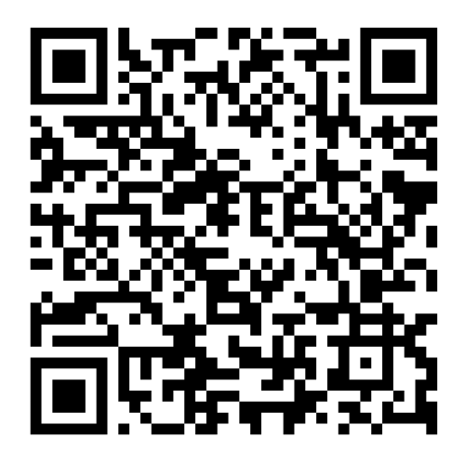
Indiana Senators & Representative
Senator Todd Young
Contact Form: https://www.young.senate.gov/contact/email-todd/
Mail: 185 Dirksen Senate Office Building
Washington, D.C. 20510
Phone: 202-224-5623
Indianapolis Phone: 317-226-6700
Senator Jim Banks
Contact Form: https://www.banks.senate.gov/share-your-opinion/
Mail: B85 Russell Senate Office Building
Washington, D.C. 20510
Phone: 202-224-4814
Fort Wayne Phone: 260-321-7130
Find you Representative here: https://www.house.gov/representatives/find-your-representative
Exodus Refugee The Life Ahead

Slide 19
State Issues

Slide 20
Governor Braun
Ask to repeal Executive Order 25-29 Supporting Federal Immigration Policy and Protecting Hoosier Workers by Indiana’s State Agencies
Requires agencies and departments of the State of Indiana, and state and local law enforcement to report to and fully cooperate with ICE
Ask to support refugees and immigrants in Indiana
Mail:
Office of the Governor
Statehouse
Indianapolis, Indiana 46204-2797
Phone – 317-232-4567
Contact Form:
https://in.accessgov.com/gov/Forms/Page/gov/ask-mike/
Exodus Refugee The Life Ahead

Slide 21
State Legislator Asks
While the 2025 Session has essentially concluded, there are still says to advocate to your state Senator and Representative.
If your Representative or Senator opposed anti-immigration legislation this session, be sure to thank them for standing up for our immigrant neighbors!
Once the session concludes, interim study committees will be formed to look at what legislation should be considered for next year, and is an important time to contact authors of bills to ask them to not reintroduce harmful legislation, and to ask committees to look at legislation that would support immigrants, such as Driving Privilege Cards.
Exodus Refugee The Life Ahead

Slide 22
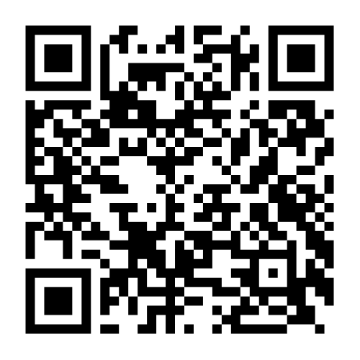
State Rep & State Senator
Find Your Legislators:
https://iga.in.gov/information/find-legislators
Exodus Refugee The Life Ahead

Slide 23
Sample Letter & Phone Calls
Dear Senator/Rep. [Last Name],
I am writing to express my deep concern about [bill number] which is currently under consideration [in the House/Senate]. This bill, in my opinion, poses significant risks to both the safety of immigrants in our state and to the economic well-being of our communities.
As one of your constituents, I urge you to oppose this bill.
I am concerned that the provisions of this bill would create an environment of fear and uncertainty for many immigrants in Indiana, including refugees, those with Temporary Protected Status, asylum seekers, and those with Humanitarian Parole. Our immigrant neighbors are valuable members of our workforce, contributing to the success and growth of Indiana’s economy. They attend our churches, go to school here, and contribute so much to our communities.
By making it more challenging for them to live and work here, this bill could ultimately reduce the labor pool and exacerbate workforce shortages in critical industries such as agriculture, hospitality, healthcare, and construction. It will make it more difficult for our communities to thrive. Indiana has long benefited from the diverse perspectives and skills brought by immigrant communities, and I am deeply concerned that this bill would undermine that.
I urge you to carefully consider the long-term consequences of this bill, not just for immigrant communities, but for the broader economy and the prosperity of Indiana as a whole. We need policies that promote inclusivity, support workers, and ensure our state remains competitive and attractive to employers and families alike.
Please consider voting against [bill #], as I believe it would have harmful consequences for both our neighbors and our state’s future. I appreciate your attention to this important issue and thank you for your service.
Sincerely, [Your Name]
Exodus Refugee The Life Ahead

Slide 24
Sample Letter & Phone Calls
Dear Senator/Representative [Last Name],
I am writing to you today to express my concern about the actions taken so far by the Trump administration targeting immigrants in our country. While I understand the need for public safety, these actions are inhumane and ultimately go against the legacy of welcome upheld by the United States.
Firstly, I urge you to publicly express your support for refugees and humanitarian protections. Call on the Trump administration to immediately rescind the refugee ban, reverse course on stop-work orders, and oppose other executive orders that target our asylum-seeking and immigrant neighbors and the communities that welcome them. I urge you to be vocal in support for refugees and recognize and uplift the value refugees and newcomers bring to our community – including via press events, floor statements, and on social media.
Additionally, I want you to hold the Trump administration accountable to rulings from the courts. Many of the preliminary injunctions from ongoing litigation against the President state that Congress should be the one to exercise authority over immigration matters, not the President. It is your responsibility to represent all of your constituents, especially vulnerable humanitarian immigrants, who pursued lawful pathways to come to the United States. It is our responsibility to honor those protections as they seek safety.
It is critical that we ensure proper allocation of responsibilities and resources, Support legislation and appropriations that uphold decades of precedent for welcoming newcomers – and oppose legislation that further codifies harm to immigrants.
Thank you for your time and attention to this important issue. I appreciate your service and hope you will act in the best interest of our state, and our country.
Sincerely,
[Your Name]
Exodus Refugee The Life Ahead

Slide 25
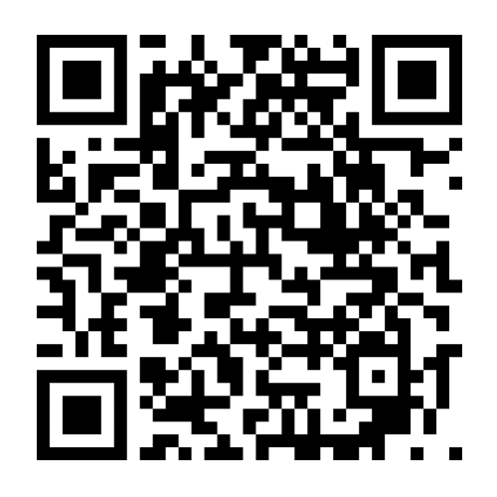
CWS Action Alerts
CWS Action Alert 4/3/25 – TAKE ACTION TODAY: Urge Your Member of Congress to Defend Refugee Resettlement
https://cwsglobal.org/action-alerts/take-action-today-urge-your-member-of-congress-to-defend-refugee-resettlement/
CWS Action Alert 3/25/25 – Protect Immigrant Children: Tell Congress to Restore Vital Services and Push Back on Rapid Deportations
https://cwsglobal.org/action-alerts/protect-immigrant-children-tell-congress-the-white-house-to-stop-deporting-unaccompanied-migrant-children/
Exodus Refugee The Life Ahead

Slide 26
Questions?

Slide 27
Thank you!
Exodus Refugee Immigration
2457 E. Washington St., Suite A
Indianapolis, Indiana 46201
(317) 921-0836
www.exodusrefugee.org
Facebook: Exodus Refugee Immigration
Instagram: @exodus_refugee
LinkedIn: Exodus Refugee Immigration
Notes:
This is the end of our presentation. Thank you for spending the time with me to learn about how to get involved with Exodus Refugee and our mission to facilitate the life ahead for our clients. Our office address is present on this slide as well as our office phone number. If you have any questions about volunteer engagement beyond the contents of this video or the details of this website, please feel free to reach out to us. We are happy to answer any questions you might have. We look forward to serving with each of you and I hope that you have a great day.

